Slide 1
Diode Types
Solar Cell
Photo Diode
Light Emitting Diode
Schottky Barrier Diode
Zener Diode

Slide 2
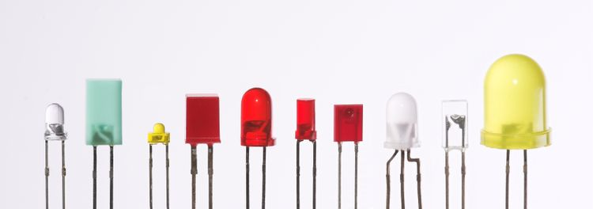
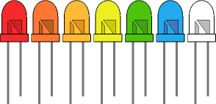
Light Emitting Diodes (LED)
A PN junction diode, which emits light when forward biased, is known as light emitting diode.
The emitted light may be visible or invisible
The amount of light output is directly proportional to the forward current.
Thus higher the forward current, higher is the light output

Slide 3
Light Emitting Diodes (LED)
The schematic symbol of a light emitting diode is shown in figure.
The arrows pointing away from the diode symbol represent the light, which is being transmitted away from the junction.
Anode A
Cathode K
Circuit symbol

Slide 4
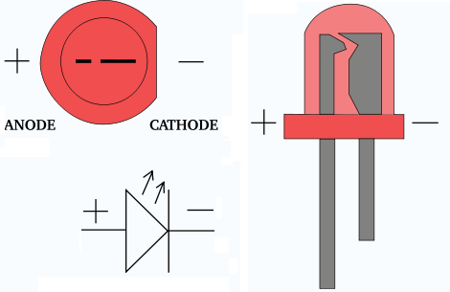
Light Emitting Diodes (LED)
sign: | + | -
terminal: | anode (A) | cathode (K)
leads: | long | short
exterior: | round | flat
interior: | small | large
wiring: | red | black
*marking: | none | stripe
*pin: | 1 | 2
*Die placement: | connector | cup
Electrical polarity
Anode A
Cathode K
Circuit symbol

Slide 5
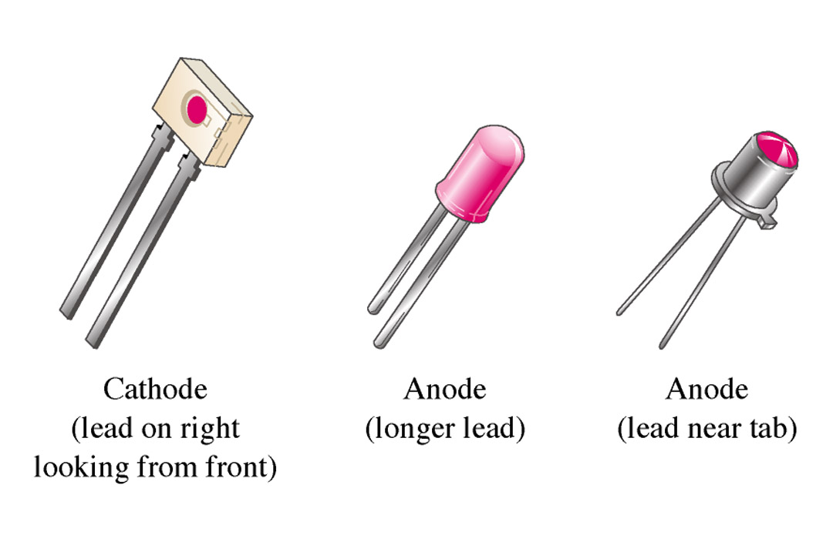
FIGURE 3-30 Typical LEDs.
Thomas L. Floyd Electronic Devices, 6e and Electronic Devices: Electron Flow Version, 4e

Slide 6
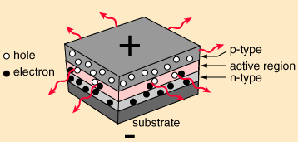
Construction of LED
The construction of LED is same as that of a p-n junction semiconductor diode.
One of the popular methods of construction of LED is to deposite three semiconductor layers on the substrate as shown in figure.
The active region is exist between the p and n regions. The light emerges from the active side in all the directions when electron hole pairs recombine.
+
P-region
P – region
Active region
Active region
N-region
N – region
substrate
Substrate
-

Slide 7
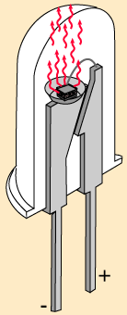
Construction of LED
In this particular structure, the LED emit light all the way around the layered structure. Thus the basic layered structure is placed in a tiny reflective cup so that the light from the active layer will be reflected towards desired exit direction.

Slide 8
Materials and colours
The LEDs use mixtures of Gallium (Ga), Arsenic (As) and Phosphorous (P).
The colour of emitted light is decided by its wavelength which depends on forbidden energy gap.
This gap is different for different mixtures. Hence different mixtures give the different colours.
No. | Mixture used | Symbol | Colour
1 | Gallium Arsenide | GaAs | Infrared, invisible
2 | Gallium Phosphide | GaP | Red or Green
3 | Gallium arsenide Phosphide | GaAsP | Red or Yellow
Silicon and germanium are not used for LEDs because their forbidden gap do not allows the light emission in visible spectrum.

Slide 9
Principle of LED operation
When the LED is forward biased, the electrons in the n-region will cross the junction and recombine with the holes in the p-type materials.
These free electrons resides in the conduction band and hence at a higher energy level than the holes in the valence band.
When recombination takes place, these electrons return back to the valence band which is at lower energy level than the conduction band.
While returning back, the recombining electrons gives away the excess energy in the form of light. This process is called as electroluminescence.
Conduction band
Forbidden
gap
Light output
Recombination of
Holes and electrons
Valence band

Slide 10
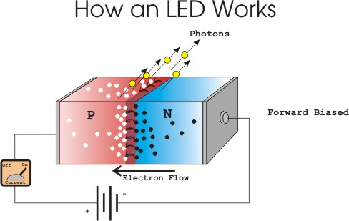
Principle of LED operation
Conduction band
Forbidden
gap
Light output
Recombination of
Holes and electrons
Valence band

Slide 11
LED biasing
The voltage drop across a conducting LED is in the range of 1.2 V to 3.2 V, depending on the material used.
This voltage is much higher than that across a conventional diode. The current range of the LEDs available in the market is 10 to 80 mA.
LEDs have extremely low reverse breakdown voltage of the order of 3 to 10 V. So they should not be subjected to high reverse voltage.

Slide 12
LED biasing
Light
output
R
V
I_{F}
I_{F} in mA
Forward biasing

Slide 13
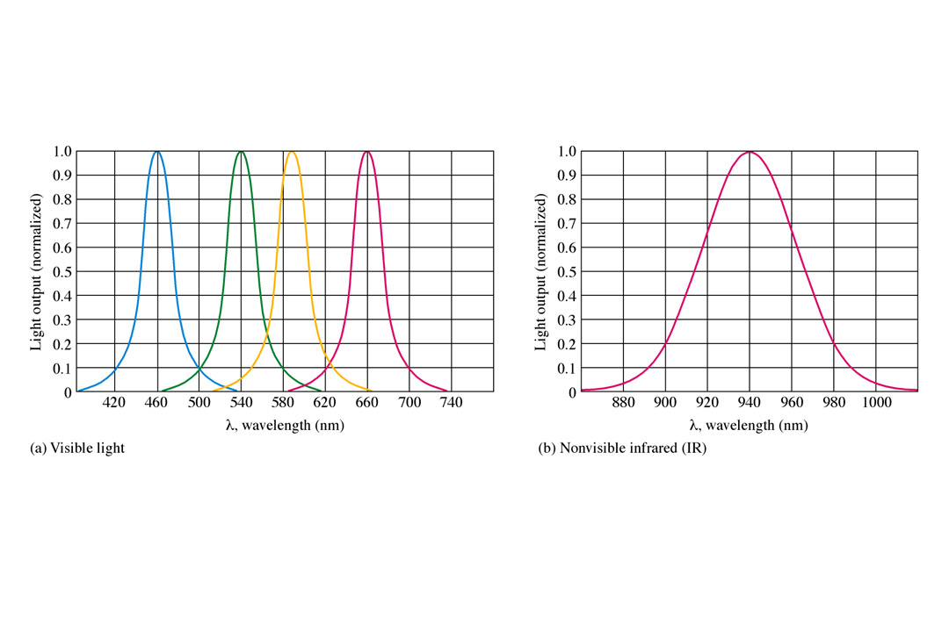
Spectral response curves of LED
The graph of output light ( Y light ) versus the wavelength is called as the spectral response curve of an LED.

Slide 14
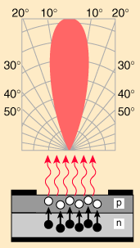
Radiation pattern of LED
The radiation pattern is a graph of light output plotted against angle as shown in figure. It gives idea about how directional the given light source is.
The LED is a highly directional source because it radiates only in a particular direction.
Most of the radiated energy is confined within 20⁰ of direction of maximum light.

Slide 15
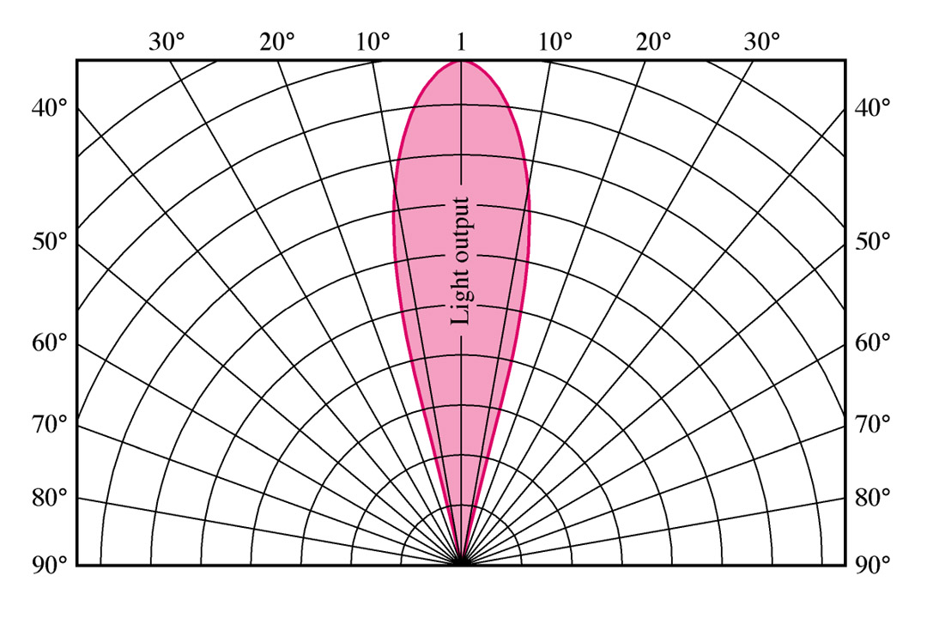
Radiation pattern of LED
The radiation pattern is a graph of light output plotted against angle as shown in figure. It gives idea about how directional the given light source is.
The LED is a highly directional source because it radiates only in a particular direction.
Most of the radiated energy is confined within 20⁰ of direction of maximum light.

Slide 16
Advantages of LEDs
LEDs are of small size and light weight. Therefore it is possible to pack a large number of LED in a small space while manufacturing a display.

Slide 17
Advantages of LEDs
LEDs are of small size and light weight. Therefore it is possible to pack a large number of LED in a small space while manufacturing a display.
They are available in a different spectral colours.

Slide 18
Advantages of LEDs
LEDs are of small size and light weight. Therefore it is possible to pack a large number of LED in a small space while manufacturing a display.
They are available in a different spectral colours.
They have larger life as compared to the lamps.

Slide 19
Advantages of LEDs
LEDs are of small size and light weight. Therefore it is possible to pack a large number of LED in a small space while manufacturing a display.
They are available in a different spectral colours.
They have larger life as compared to the lamps.
The light emitted by a LED is proportional to the amount of current flowing through it. Hence we can control the current flowing through the LEDs to vary their brightness as per the requirements of the application.

Slide 20
Advantages of LEDs
LEDs are of small size and light weight. Therefore it is possible to pack a large number of LED in a small space while manufacturing a display.
They are available in a different spectral colours.
They have larger life as compared to the lamps.
The light emitted by a LED is proportional to the amount of current flowing through it. Hence we can control the current flowing through the LEDs to vary their brightness as per the requirements of the application.
They are suitable at high operating speeds as they takes less than 1 μs to turn on or off.

Slide 21
Advantages of LEDs
LEDs are of small size and light weight. Therefore it is possible to pack a large number of LED in a small space while manufacturing a display.
They are available in a different spectral colours.
They have larger life as compared to the lamps.
The light emitted by a LED is proportional to the amount of current flowing through it. Hence we can control the current flowing through the LEDs to vary their brightness as per the requirements of the application.
They are suitable at high operating speeds as they takes less than 1 μs to turn on or off.
LEDs can be easily interfaced with the other electronic circuits

Slide 22
Disadvantages of LEDs
Output power is affected by changes in temperature.
Over current can damage it easily.
They need larger power for their operation

Slide 23
Applications of LEDs
In the optocouplers.
In the infrared remote controls.
As indicators in various electronic circuits.
In seven segment and alphanumeric display.

Slide 24
Comparison of LED and p-n junction diode

Slide 25
Comparison of LED and p-n junction diode
LED
It emits light, when forward bias.
P-n junction diode

Slide 26
Comparison of LED and p-n junction diode
LED
It emits light, when forward bias.
P-n junction diode
It does not emits light

Slide 27
Comparison of LED and p-n junction diode
LED
It emits light, when forward bias.
p-n junction diode
It does not emits light

Slide 28
Comparison of LED and p-n junction diode
LED
It emits light, when forward bias.
It uses material like gallium arsenide Phosphide and gallium Phosphide.
p-n junction diode
It does not emits light

Slide 29
Comparison of LED and p-n junction diode
LED
It emits light, when forward bias.
It uses material like gallium arsenide Phosphide and gallium Phosphide.
p-n junction diode
It does not emits light
It uses material like silicon and germanium

Slide 30
Comparison of LED and p-n junction diode
LED
It emits light, when forward bias.
It uses material like gallium arsenide Phosphide and gallium Phosphide.
The drop across forward biased LED is about 2 V
p-n junction diode
It does not emits light
It uses material like silicon and germanium

Slide 31
Comparison of LED and p-n junction diode
LED
It emits light, when forward bias.
It uses material like gallium arsenide Phosphide and gallium Phosphide.
The drop across forward biased LED is about 2 V
p-n junction diode
It does not emits light
It uses material like silicon and germanium
The drop across forward biased diode is about 0.7 V.

Slide 32
Comparison of LED and p-n junction diode
LED
It emits light, when forward bias.
It uses material like gallium arsenide Phosphide and gallium Phosphide.
The drop across forward biased LED is about 2 V
Reverse breakdown voltage is low, about 3 V to 10 V.
p-n junction diode
It does not emits light
It uses material like silicon and germanium
The drop across forward biased diode is about 0.7 V.

Slide 33
Comparison of LED and p-n junction diode
LED
It emits light, when forward bias.
It uses material like gallium arsenide Phosphide and gallium Phosphide.
The drop across forward biased LED is about 2 V
Reverse breakdown voltage is low, about 3 V to 10 V.
p-n junction diode
It does not emits light
It uses material like silicon and germanium
The drop across forward biased diode is about 0.7 V.
Reverse breakdown voltage is high, about 50 V and more.

Slide 34
Comparison of LED and p-n junction diode
LED
It emits light, when forward bias.
It uses material like gallium arsenide Phosphide and gallium Phosphide.
The drop across forward biased LED is about 2 V
Reverse breakdown voltage is low, about 3 V to 10 V.
The applications are optocouplers seven segment displays, etc.
p-n junction diode
It does not emits light
It uses material like silicon and germanium
The drop across forward biased diode is about 0.7 V.
Reverse breakdown voltage is high, about 50 V and more.

Slide 35
Comparison of LED and p-n junction diode
LED
It emits light, when forward bias.
It uses material like gallium arsenide Phosphide and gallium Phosphide.
The drop across forward biased LED is about 2 V
Reverse breakdown voltage is low, about 3 V to 10 V.
The applications are optocouplers seven segment displays, etc.
p-n junction diode
It does not emits light
It uses material like silicon and germanium
The drop across forward biased diode is about 0.7 V.
Reverse breakdown voltage is high, about 50 V and more.
The applications are rectifiers, clippers, clampers, voltage multipliers, etc..

Slide 36
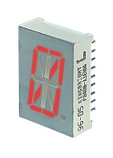
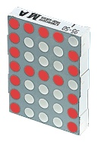
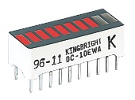
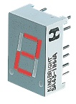
LEDs configurations
LED displays are packages of many LEDs arranged in a pattern, the most familiar pattern being the 7-segment displays for showing numbers (digits 0-9). The pictures below illustrate some of the popular designs:
Bargraph | 7-segment | Starburst | Dot matrix

Slide 37
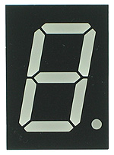
Single Digit Seven-Segment LED Display
Features • Low Current Consumption • High Brightness • Easy to Use • PCB Mounting

Slide 38
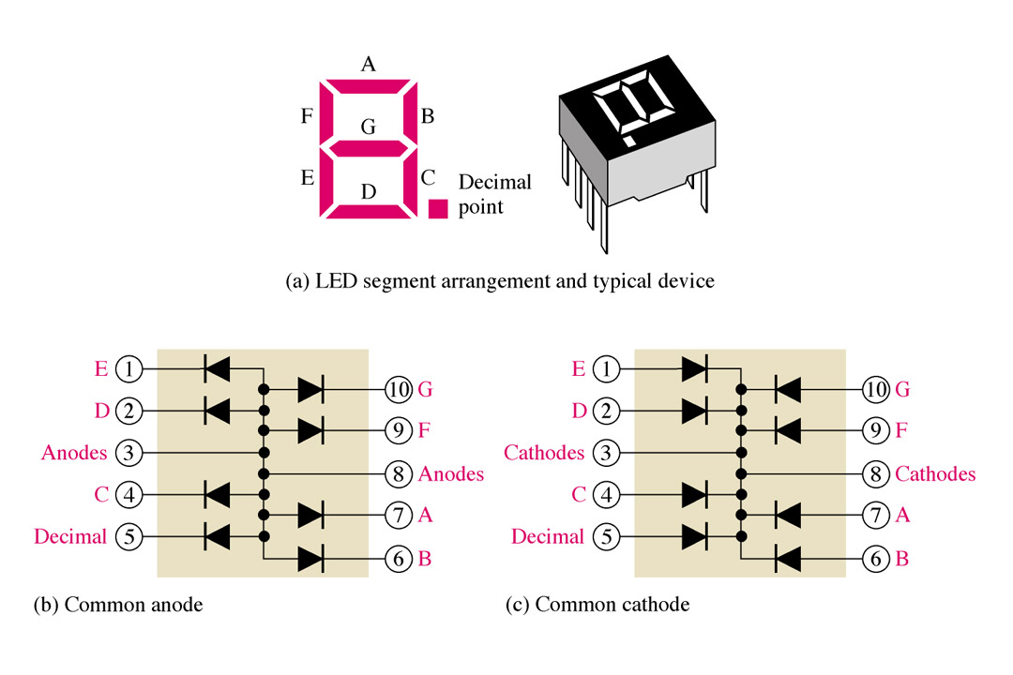
FIGURE The 7-segment LED display.
Thomas L. Floyd Electronic Devices, 6e and Electronic Devices: Electron Flow Version, 4e

Slide 39
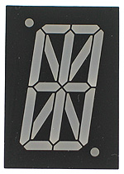
16-Segment LED Display
Features • Low Current Consumption • High Brightness • Easy to Use • PCB Mounting
Starburst

Slide 40
16-Segment LED Display
A sixteen-segment display, sometimes called a "Union Jack" display or a "British Flag" display, is a type of display based on 16 segments that can be turned on or off according to the graphic pattern to be produced. It is an extension of the more common seven-segment display, adding four diagonal and two vertical segments and splitting the three horizontal segments in half (A fourteen-segment display splits only the middle one).
Starburst

Slide 41
16-Segment LED Display
Before the advent of inexpensive dot-matrix displays, sixteen and fourteen-segment displays were some of the few options available for producing alphanumeric characters on calculators and other embedded systems. However, they are still sometimes used on VCRs, car stereos, microwave ovens, telephone Caller ID displays, and slot machine readouts.
Starburst

Slide 42
Dot matrix
A dot matrix is a 2-dimensional array of dots used to generate characters, symbols and images.
The display consist of a matrix of LEDs arranged in a rectangular configuration.
By switching on or off the selected LED’s text or graphics can be displayed.
A matrix driver or controller converts the instructions from a processor into signal which turns on or off LED’s in the matrix
 |  |  | Dot matrix

Slide 43
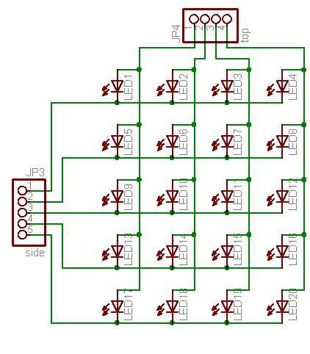
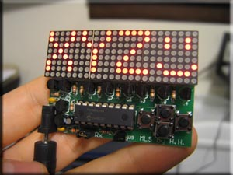
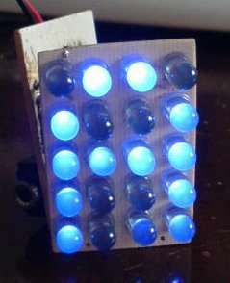
Dot matrix
 |  |  | Dot matrix

Slide 44
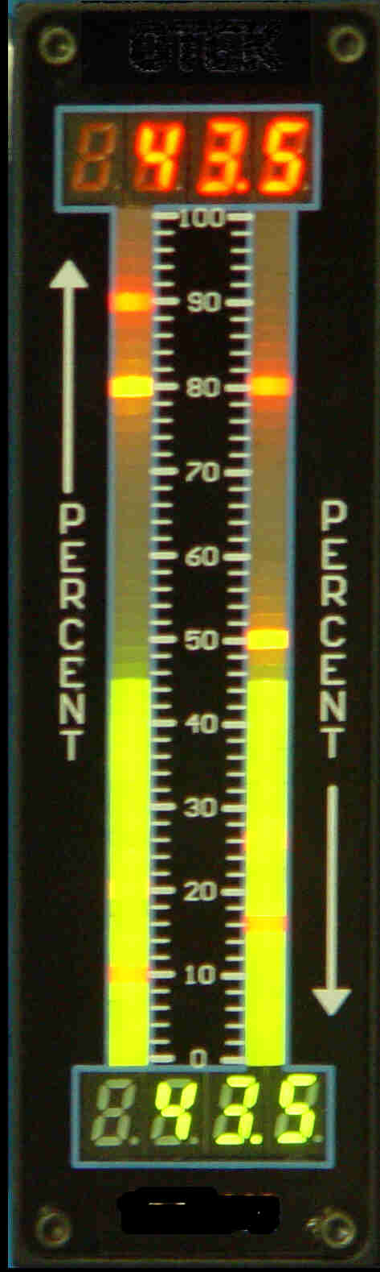

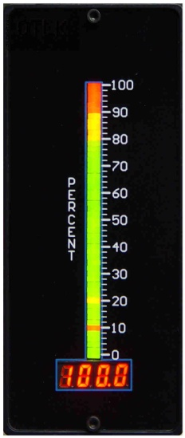
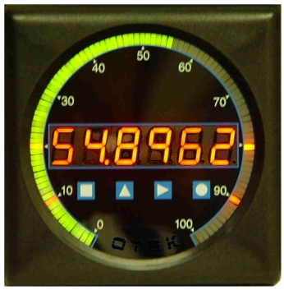
10 LED Bargraph Displays
Features • Low Current Consumption • High Brightness • Easy to Use • PCB Mounting
Bargraph

Slide 45
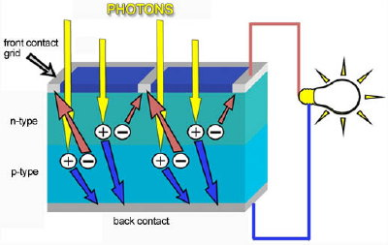
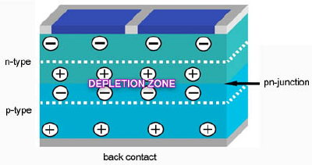
Solar Cell
Q: Explain the working of solar
cell with application?
Solar cell: Solar cell is a photovoltaic device that converts the light energy into electrical energy based on the principles of photovoltaic effect

Slide 46
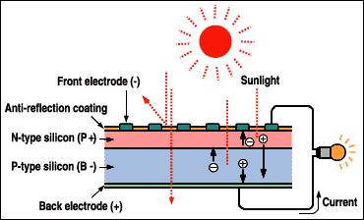
CLASSIFICATION OF TRANSDUCERS According to Transduction Principle
PHOTOVOLTAIC TRANSDUCTION :
In photovoltaic transduction the measurand is converted to voltage generated when the junction between dissimilar material is illuminated as shown in fig.

Slide 47
Physics of Photovoltaic Generation
n-type semiconductor
+ + + + + + + + + + + + + + +
Depletion Zone
- - - - - - - - - - - - - - - - - -
p-type semiconductor

Slide 48
Photovoltaic effect
Light energy
Definition:
The generation of voltage across the PN junction in a semiconductor due to the absorption of light radiation is called photovoltaic effect. The Devices based on this effect is called photovoltaic device.
n-type semiconductor
Electrical Power
p- type semiconductor
p-n junction

Slide 49
Solar panel (or) solar array (or) Solar module
The solar panel (or) solar array is the interconnection of number of solar module to get efficient power.
A solar module consists of number of interconnected solar cells.
These interconnected cells embedded between two glass plate to protect from the bad whether.
Since absorption area of module is high, more energy can be produced.

Slide 50
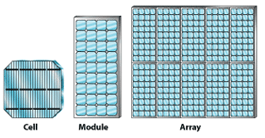

Slide 51
Materials for Solar Cell
Solar cells are composed of various semiconducting materials
Crystalline silicon
Cadmium telluride
Copper indium diselenide
Gallium arsenide
Indium phosphide
Zinc sulphide
Note: Semiconductors are materials, which become electrically conductive when supplied with light or heat, but which operate as insulators at low temperatures

Slide 52
Construction of Solar Cell
Solar cell (crystalline Silicon) consists of a n-type semiconductor (emitter) layer and p-type semiconductor layer (base). The two layers are sandwiched and hence there is
formation of p-n junction.
The surface is coated with anti-refection coating to avoid the loss
of incident light energy due to reflection.
A proper metal contacts are made on the n-type and p- type side
of the semiconductor for electrical connection

Slide 53
Working of solar cell
When a solar panel exposed to sunlight , the light energies
are absorbed by a semiconductor materials.
Due to this absorbed energy, the electrons are liberated and produce the external DC current.
The DC current is converted into 240-volt AC current using an inverter for different applications.

Slide 54
Working of solar cell
It is a pn junction device with no voltage directly applied across the junction.
When light hits the space charge region, electrons and holes are generated.
They are then quickly seperated and swept out of the
space charge region by the electric field, thus creating
PHOTON CURRENT.

Slide 55
Application
Soar pumps are used for water supply.
Domestic power supply for appliances include refrigeration, washing machine, television and lighting
Ocean navigation aids: Number of lighthouses and most buoys are powered by solar cells
Telecommunication systems: radio transceivers on mountain tops, or telephone boxes in the country can often be solar powered
Electric power generation in space: To providing electrical power to satellites in an orbit around the Earth

Slide 56

Photodiodes
Photodiode (pn junction) operated in reverse bias.
In a reverse biased p-n junction a Reverse Saturation Current flows due to minority carriers which are thermally generated.
Increasing the reverse bias does not increases the reverse current significantly.
TEMPERATURE and ILLUMINATION increases number of minority carriers (reverse) current.

Slide 57
The photons impacting the junction cause covalent bonds to break.
The electric field in the depletion layer sweeps Minority electrons in p side to n side and minority holes in n side to the p-side.
Reverse current across junction- photocurrent is proportional to the intensity of the incident light.
Response time is fast (nanoseconds)

Slide 58
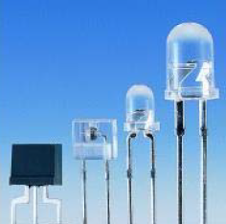
Materials used to produce photodiodes
Silicon
Germanium
Indium Gallium Arsenide
Lead Sulphide

Slide 59
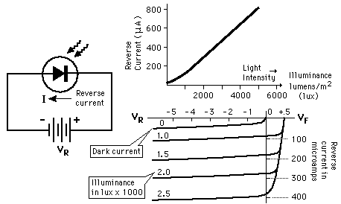

Slide 60
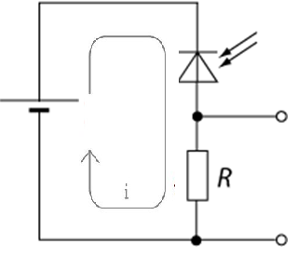
Photodiode Circuit
If photon intensity is zero.
Only current flowing is the reverse saturation current.
( Dark current , normally small ).
Photon intensity of sufficient energy strikes the diode.
Photoelectric effect ( electron hole pair in
space charge region)
Photocurrent flows in reverse direction.
Photocurrent is sum of dark current and the light current.
Photocurrent creates voltage drop across R.

Slide 61
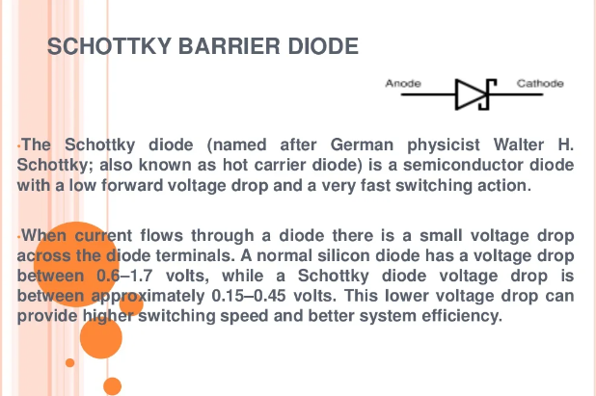
Schottky Diode

Slide 62
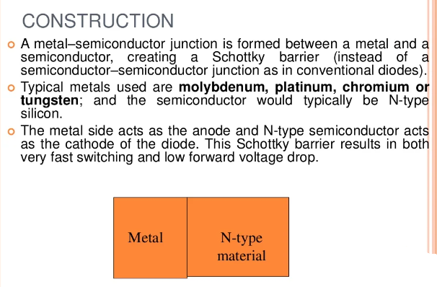

Slide 63
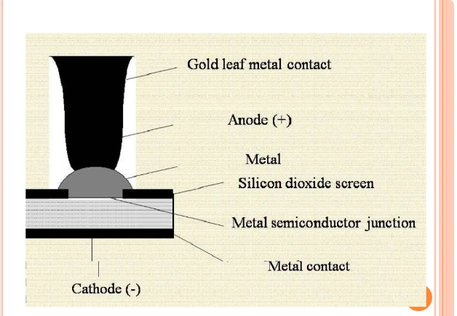

Slide 64
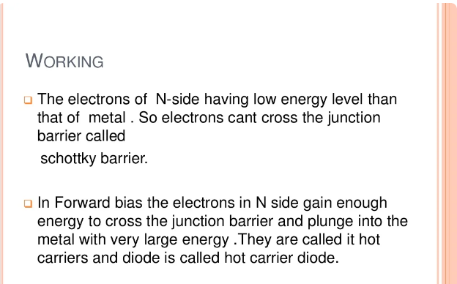

Slide 65
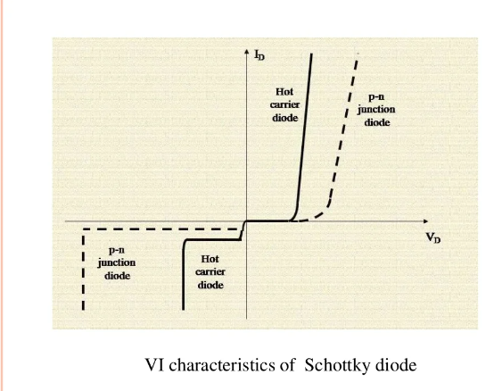

Slide 66
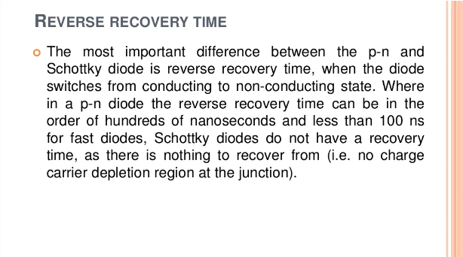

Slide 67
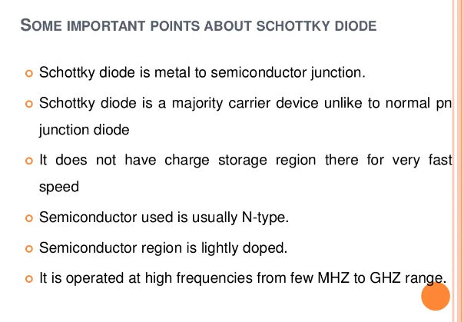

Slide 68
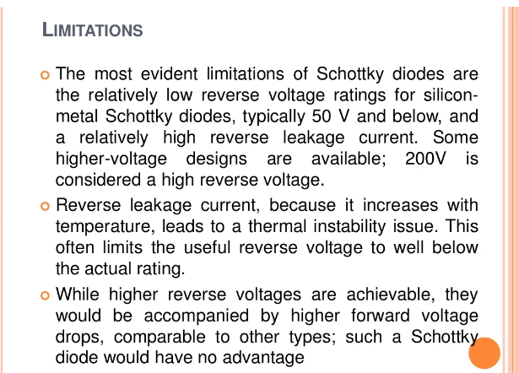

Slide 69
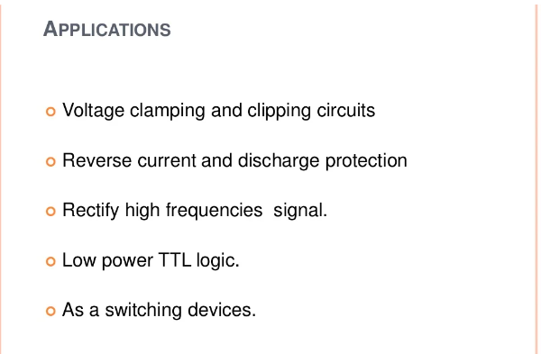

Slide 70
Schottky diode
Advantages:
High speed, high frequency, low forward voltage
drop, low heat dissipation, low loss.
Disadvantages:
Size and cost.

